Slide 1
The Greenhouse Effect

Slide 2
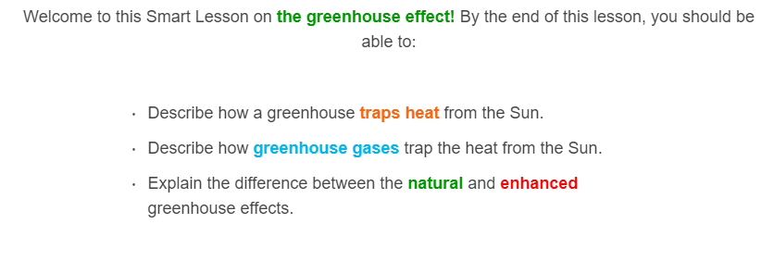
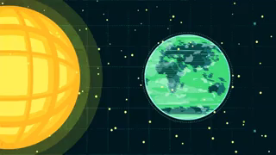

Slide 3
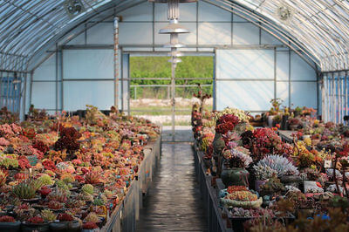
In some parts of the world, it gets too cold to grow certain fruit and vegetables!
A greenhouse is a structure that is used to grow out-of-season or weather sensitive plants.
Weather sensitive can refer to a variety of factors, such as temperature, humidity, wind, rain or snow.

Slide 4
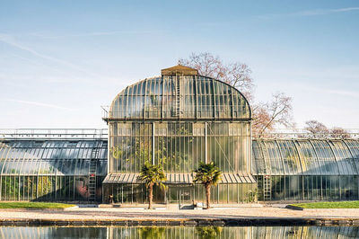
Using a greenhouse offers two advantages over planting outdoors:
• | Protection from rough weather, such as rain, snow or heavy winds.
• | Control over the temperature.

Slide 5
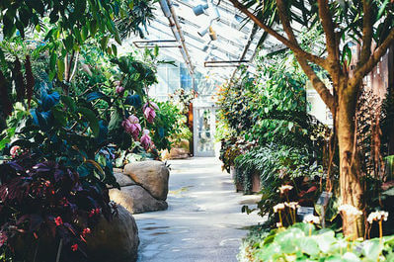
Greenhouses are usually made using glass or plastic. Sunlight (short-wave radiation) is able to pass through these materials, which heats the ground and air inside the greenhouse:
⋅ | The warm ground emits heat as infrared waves (long-wave radiation) which are reflected by the glass or plastic.
⋅ | The warm air tries to rise, but is contained by the walls and roof.
This cause the inside of the greenhouse to heat up!

Slide 6
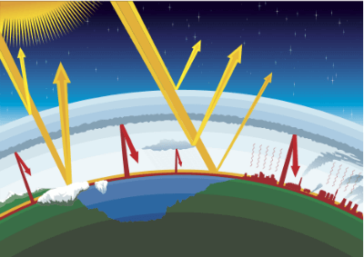
The greenhouse effect describes the same process, but on a much larger scale!
Sunlight (short-wave radiation) mostly passes through the atmosphere, where it heats the ground and oceans. This heat is emitted as infrared radiation (long-wave radiation), which is mostly reflected by certain gases in the atmosphere.
This is a naturally occurring process that has kept our planet at a comfortable temperature for thousands of years!

Slide 7
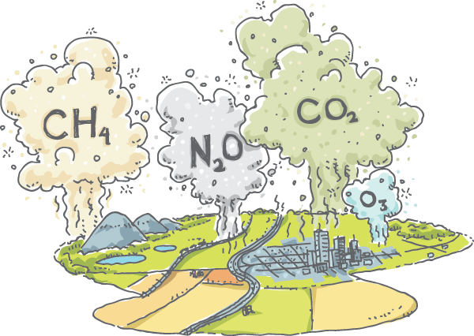
The gases in the atmosphere that cause this effect are known as greenhouse gases.
Greenhouse gases include methane (CH₄​), water vapour (H_{2​}O), carbon dioxide (CO₂​), nitrous oxide (N₂​O) and ozone (O₃​).

Slide 8
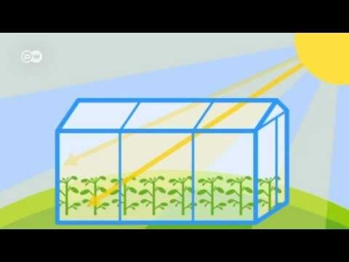
The greenhouse effect is the trapping of the Sun's heat radiation by the Earth's atmosphere.

Slide 9
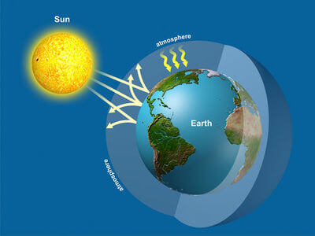
The greenhouse effect is the trapping of the Sun's heat radiation by greenhouse gases in the Earth's atmosphere.
The short-wave heat radiation is able to pass through the atmosphere, but the reflected long-wave heat radiation is not able to pass back out.

Slide 10

If you have trouble telling them apart, try to remember it this way:
Sunlight is short-wave radiation. | The ground loses heat through long-wave radiation.
Short-wave radiation is small, and can sneak past the greenhouse gases. | Long-wave radiation is large, and cannot sneak past the greenhouse gases.

Slide 11
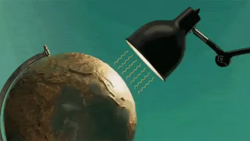
A greenhouse gas can trap a certain amount of heat.
If we increase the amount of greenhouse gases in the atmosphere, we increase the amount of heat that gets trapped!
The more greenhouse gases in the atmosphere, the warmer the planet becomes.

Slide 12
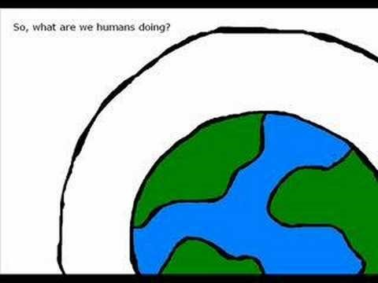

Slide 13
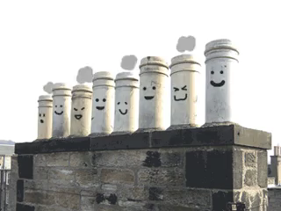
Greenhouse gases can be natural, man-made or both.
For example:
Ozone occurs naturally.
CFCs (chlorofluorocarbons) are man-made.
Carbon dioxide can be from man-made or natural sources.
Fortunately, CFCs have been phased out, now that we know the dangers they pose to the ozone layer!

Slide 14
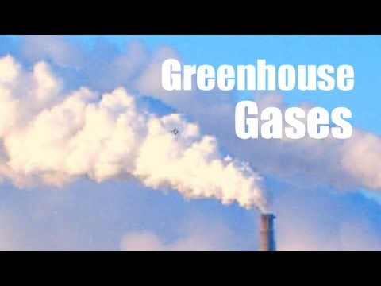

Slide 15
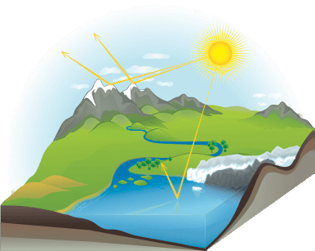
The greenhouse effect has been around as long as there has been life on Earth. About half of the radiation that passes through Earth's atmosphere will heat the planet.
The other half is reflected back out into space by ice, clouds and water.

Slide 16
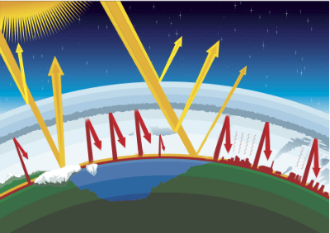
Many people do not realise that the greenhouse effect is a natural effect and is necessary to keep the planet at liveable temperatures.
The enhanced greenhouse effect refers to the unnatural, human-influenced intensification of the effect. This will be covered in another lesson called
The Enhanced Greenhouse Effect.
On the left is the natural effect, on the right is the enhanced effect.

Slide 17
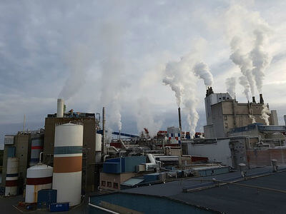
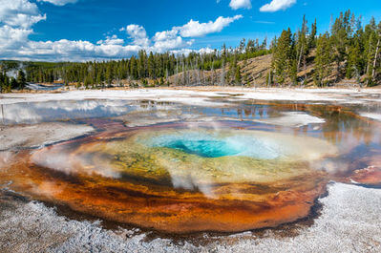
This is a very important distinction to understand:
 | Greenhouse Effect |  | Enhanced Greenhouse Effect
⋅ | Occurs naturally | ⋅ | Increased carbon emissions (such as burning fossil fuels).
⋅ | Has been around for millions of years | ⋅ | Has only been around since the Industrial Revolution
⋅ | Maintains a comfortable temperature | ⋅ | Heats the planet more every year

Slide 18

Nowadays, when people mention the greenhouse effect, they are often referring only to the enhanced greenhouse effect, and not the natural effect.
You can usually tell by the context; if someone says humans are causing the greenhouse effect, they probably aren't referring to the natural, million-year-old effect!

